Slide 1
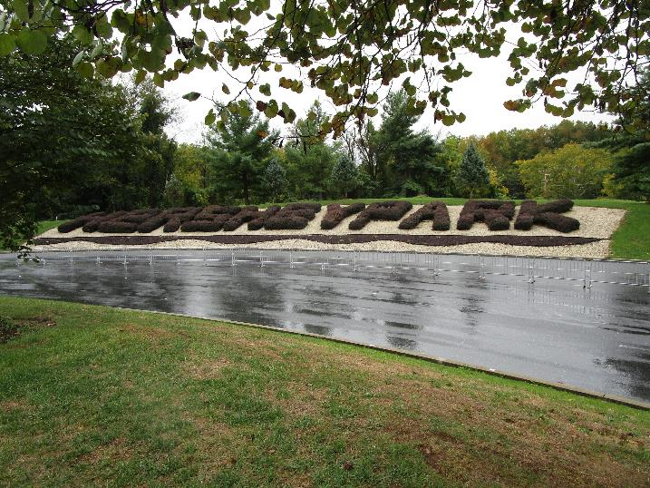
Hershey 2022
Hershey 2022 started cold and wet

Slide 2
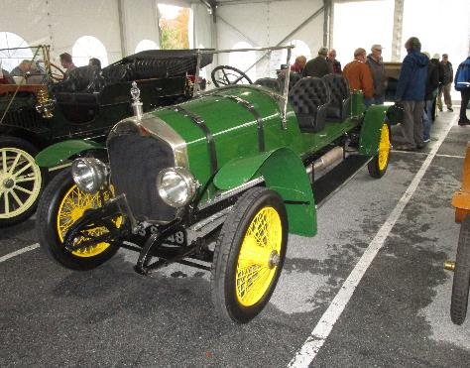
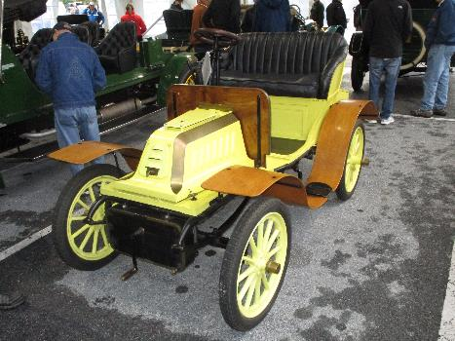
Hershey 2022
Cars of Hershey
1903 De Dion-Bouton
1921 Napier T75 Speedster

Slide 3
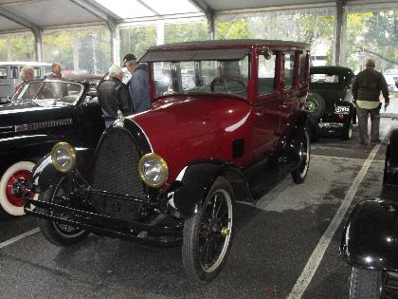
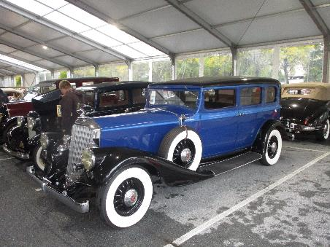
Hershey 2022
Cars of Hershey
1933 Pierce-Arrow 8
1923 Franklin

Slide 4
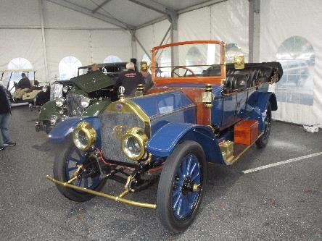
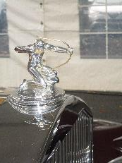
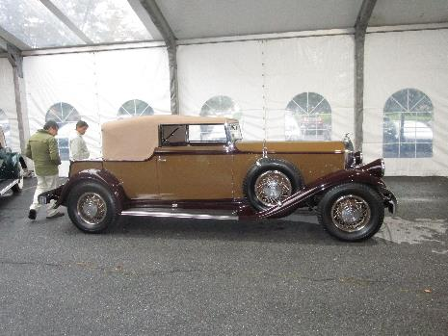
Hershey 2022
Cars of Hershey
1931 Pierce-Arrow Model 41
1912 FIAT Type 56

Slide 5
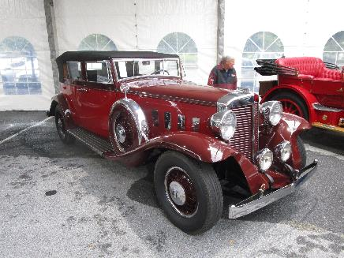
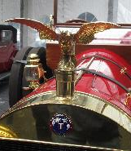
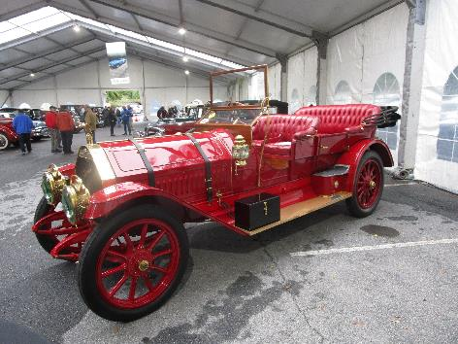
Hershey 2022
Cars of Hershey
1914 Thomas Model K-6 90 Flyabout
1931 Marmon Sixteen

Slide 6
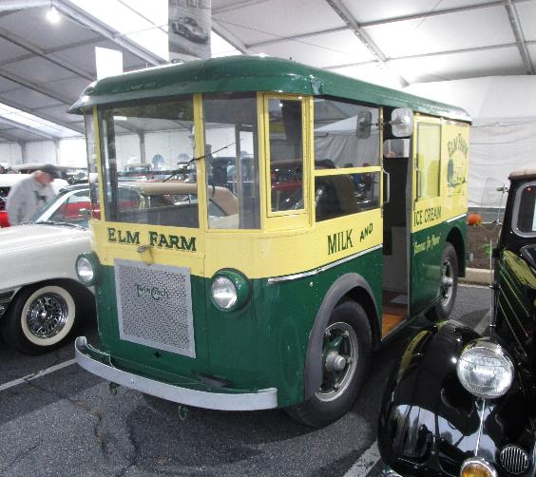
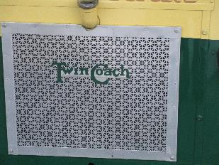
Hershey 2022
Cars of Hershey
1933 Twin Coach Delivery Truck

Slide 7
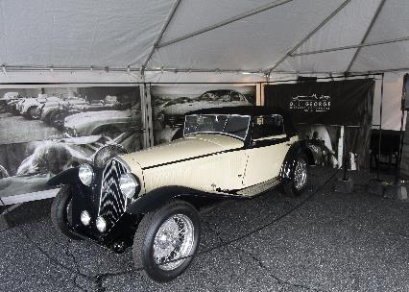
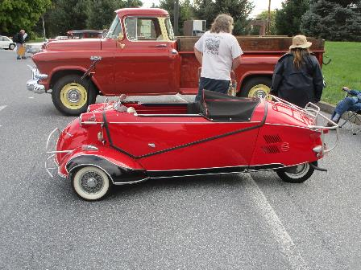
Hershey 2022
Cars of Hershey
1956 Messerschmitt KR200
ca 1938 Alfa Romeo

Slide 8
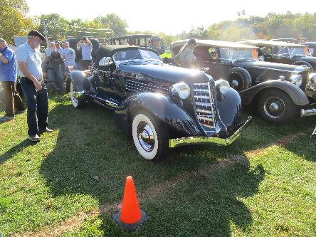
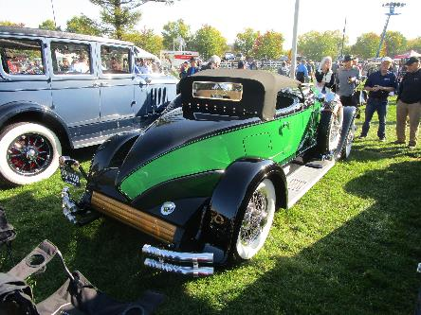
Hershey 2022
Cars of Hershey
1928 Auburn 8-115 Speedster
1935 Auburn 851 Speedster

Slide 9
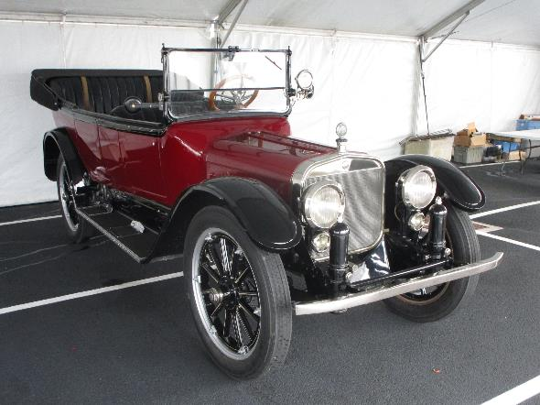
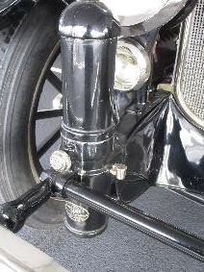
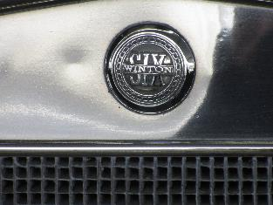
Hershey 2022
Cars of Hershey
1912 Winton 6
Air cylinders mounted between spring and frame to improve ride, hydraulic damping incorporated

Slide 10
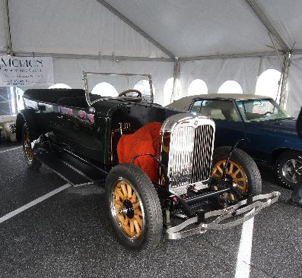
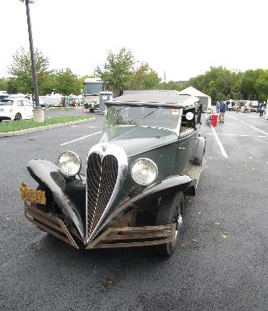
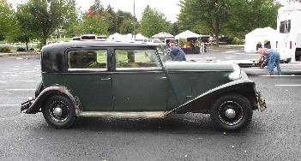
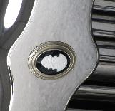
Hershey 2022
Cars of Hershey
1933 Brewster Ford
Ca 1928 Lafayette

Slide 11
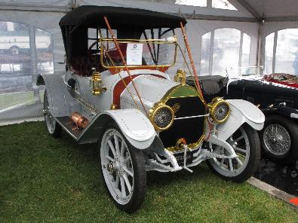
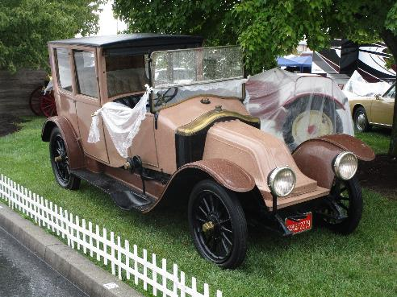
Hershey 2022
Cars of Hershey
Renault
1912 Cartercar, friction drive

Slide 12
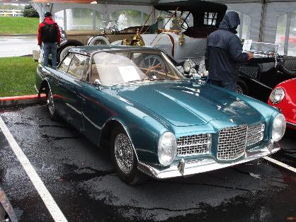
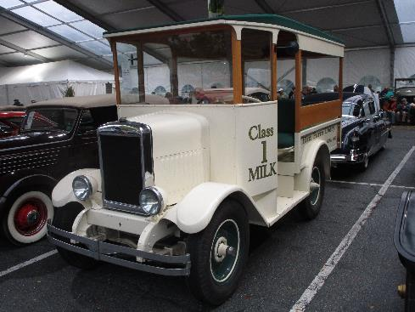
Hershey 2022
Cars of Hershey
1931 Divco Model H Milk Truck
1963 Facel Vega Facel II
Equipped with a Chrysler 383 CID V8

Slide 13
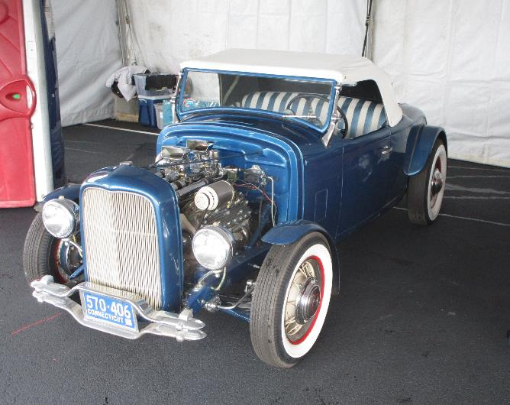
Hershey 2022
Cars of Hershey
Bo Ritchie Roadster
Built in 1954
1931 Chrysler body, 1940 Ford chassis

Slide 14
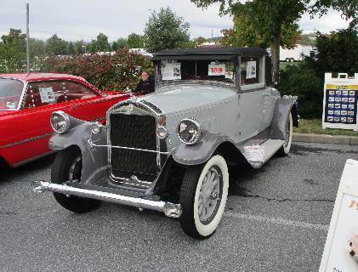
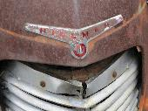
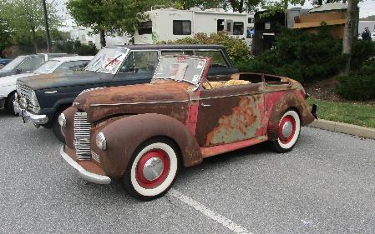
Hershey 2022
Cars of Hershey
1948 Hillman Minx
1928 Pierce-Arrow Model 81

Slide 15
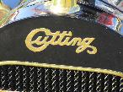
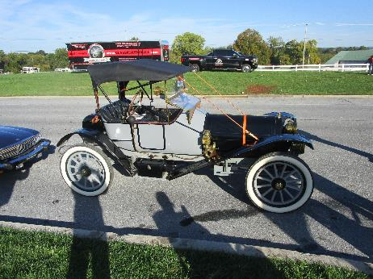
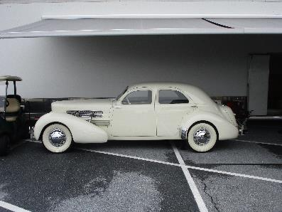
Hershey 2022
Cars of Hershey
1937 Cord 812 Beverly
ca 1910 Cutting
Made in western Michigan

Slide 16
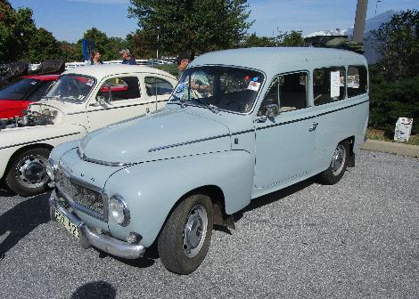
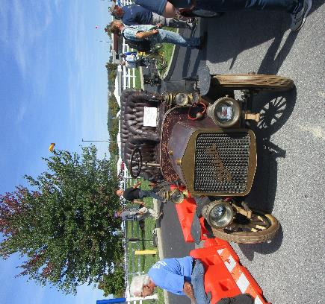
Hershey 2022
Cars of Hershey
ca 1948 Volvo
1906 Buick Model F

Slide 17
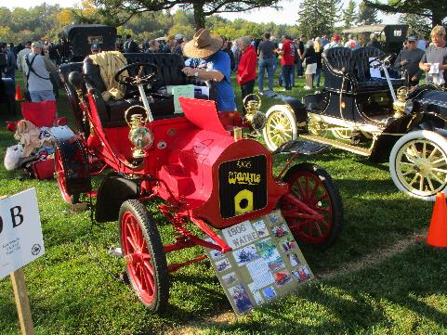
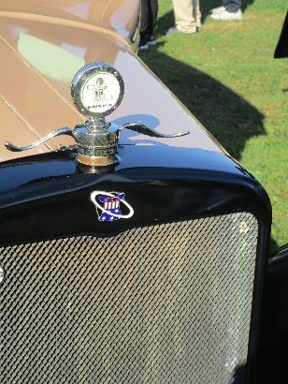
Hershey 2022
Cars of Hershey
ca 1926 Rickenbacker
“my hat is in the ring”
1906 Wayne
Predecessor to EMF, which led to Studebaker, in Piquette Ave. plant

Slide 18
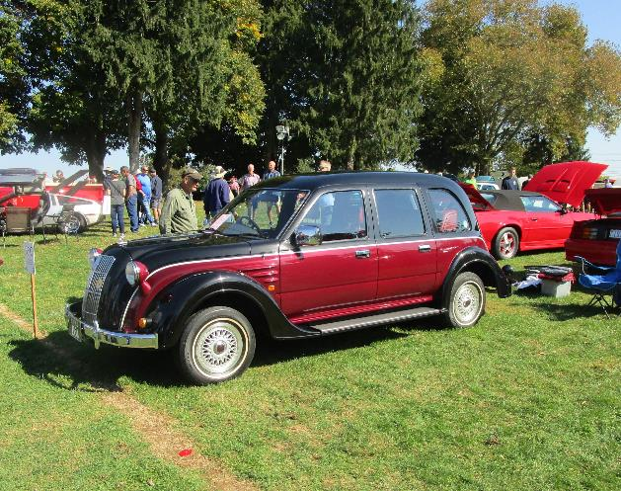
Hershey 2022
Cars of Hershey
1996 Toyota Classic
Japan home market production car, built on truck chassis.

Slide 19
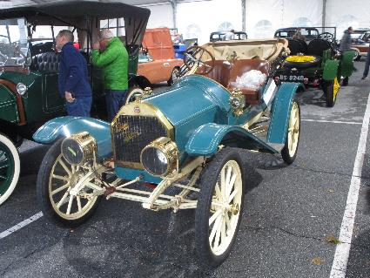
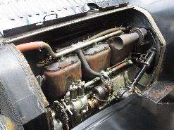
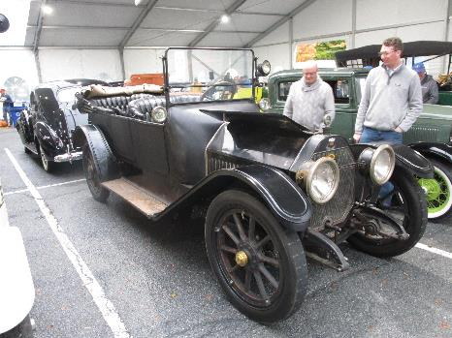
Hershey 2022
Cars of Hershey
1910 Paige-Detroit Model B roadster
1914 Haynes Model 27

Slide 20
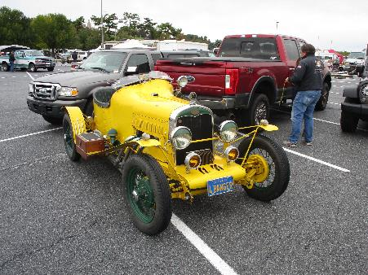
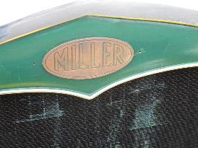
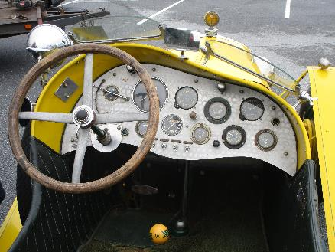
Hershey 2022
Cars of Hershey
1931 Ford Miller racer

Slide 21
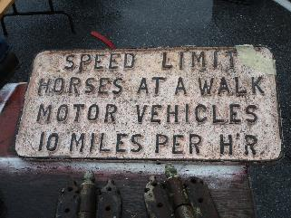
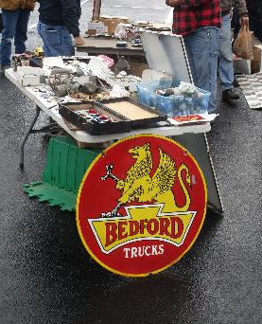
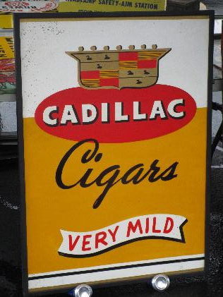
Hershey 2022
Signs of Hershey

Slide 22
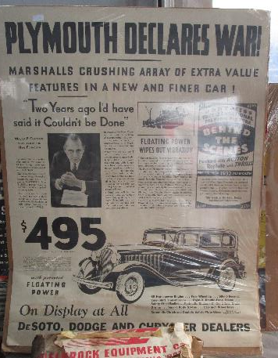

Hershey 2022
Signs of Hershey
Good to know that no matter which direction you choose, there’s a fire escape
“Plymouth Declares War!”

Slide 23



Hershey 2022
Signs of Hershey
Filco, “the crown jewels of ignition”

Slide 24


Hershey 2022
Signs of Hershey

Slide 25



Hershey 2022
Parts of Hershey
Packard trunk
Fenders
Cadillac – Olds air cleaner

Slide 26



Hershey 2022
Parts of Hershey
Over a few days, this pile of Cadillac parts grew to include a whole car.

Slide 27



Hershey 2022
Parts of Hershey
Packard V12
Dual carb manifold for Dodge & Plymouth 201, 215 and 230 CID 6 cylinder engines
Long ram intake for Chrysler

Slide 28



Hershey 2022
Parts of Hershey
Headlights for 32-33 Hudson 8
Free standing headlights for 61-63 Imperial

Slide 29



Hershey 2022
Parts of Hershey
Dual carbs for Buick nailhead V8
Duesenberg parts
LaSalle transmission with adapter to flathead Ford

Slide 30




Hershey 2022
Parts of Hershey
Curtiss aero engine, late teens
502 CID

Slide 31


Hershey 2022
Parts of Hershey
Big Block Crosley engine
59 CID, 55 HP
Dual carbs for 57 T Bird

Slide 32


Hershey 2022
Patterns of Hershey
Hudson

Slide 33


Hershey 2022
Projects
Ford projects

Slide 34



Hershey 2022
Jaguar projects
Projects
73 V12
$3500

Slide 35


Hershey 2022
Projects
1912 Cadillac project
New 1932 Ford project

Slide 36


Hershey 2022
Small cars
1938 Bantam
Citroen 2CV

Slide 37



Hershey 2022
Smaller cars

Slide 38



Hershey 2022
Buicks
1931 Buick Series 90
1931 Buick Series 60
1931 Buick Series 90 Model 94

Slide 39





Hershey 2022
Buicks
1950 Buick
1950 Buick Roadmaster

Slide 40


Hershey 2022
Fords
1936 Fords

Slide 41




Hershey 2022
Fords
71-72 Thunderbird
2 seater Thunderbird
1958 Thunderbird

Slide 42



Hershey 2022
Fords
Lincoln Blackwood
1938 Lincoln Zephyr
1957 Lincoln

Slide 43



Hershey 2022
Fords
Ford station wagon
1958 Ford Ranch Wagon
1940 Ford panel delivery

Slide 44



Hershey 2022
1971 Chevrolet C-20
Chevrolets
1936 Chevrolet
1958 Impala
Equipped with very rare Turboglide transmission

Slide 45



Hershey 2022
Nash
1974 AMC Matador coupe, with Barcelona package
1953 Nash Healey

Slide 46




Hershey 2022
Nash
1956 Nash Statesman Super
1948 Nash with Jetfire engine

Slide 47



Hershey 2022
Cadillacs
1956 Cadillac Eldorado
1956 Cadillac

Slide 48



Hershey 2022
1938 Cadillac V12
Cadillacs
1938 Cadillac V16
1930 Cadillac V16

Slide 49




Hershey 2022
Cadillacs
1941 Cadillac Series 62
1931 Cadillac V12
1928 LaSalle series 303
Mr. LaSalle waving his hat and urging everyone onward

Slide 50



Hershey 2022
Cadillacs
1946-7 Cadillac
1910 Cadillac Model 30
1905 Cadillac Model E

Slide 51



Hershey 2022
Cadillacs
Small Cadillacs

Slide 52





Hershey 2022
There will always be England
1939 Lea Francis Corsica
1939 Matford
Custom bodied Ford
1938 Aston Martin 15/98

Slide 53





Hershey 2022
There will always be England
1930 Bentley LeMans Tourer
Bentley won 5 out of the first 7 LeMans races with cars like this one.
It has a 4 ½ liter 4 cyl OHC engine

Slide 54





Hershey 2022
There will always be England
Jaguar Mark V
1957 Jaguar Mark VIII
Note that it has the automatic transmission derived from a 1950 Studebaker design
1970 Jaguar XKE

Slide 55




Hershey 2022
There will always be England
1948 Bentley Mark IV, with custom body by Franay
1934 Bentley Sports Saloon, built in Derby, England
1956 Bentley S1 Continental Sports Saloon, custom body

Slide 56

Hershey 2022
There will always be England
1952 Daimler Drophead
Built for King George VI. Delivered to Queen Elizabeth II. The Queen played a part in the design of this car.
Uses a fluid coupling and pre-selector gearbox

Slide 57

Hershey 2022
There will always be England
1965 Morris Minor Traveler

Slide 58




Hershey 2022
Chryslers
1931 DeSoto SA
1932 Chrysler CL Imperial
With correct gazelle
1933 Plymouth

Slide 59


Hershey 2022
Chryslers
1956 Plymouth Savoy
1942 Dodge ½ ton WC-4 weapons carrier

Slide 60




Hershey 2022
Chryslers
1961 DeSoto
1957 Dodge Royal
1961 Chrysler Town & Country
Wagons used 1960 body with 1961 front end

Slide 61




Hershey 2022
Packards
1941 Packard 160
1953 Packard with Ultramatic
1941 Packard

Slide 62


Hershey 2022
Pontiac
1930 Oakland
Replica of the Oakland that ran in the 1930 Indy 500
Finished 11th
V8 engine, 251 CID

Slide 63





Hershey 2022
Studebakers
1963 Studebaker Wagonaire
TT emblem indicates rare limited slip differential
1956 Studebaker Pinehurst 2 door station wagon

Slide 64



Hershey 2022
1953 EMW 327
Made from BMW pre-war tooling left in E. Germany
Note emblem is red and white, not blue and white like a real BMW

Slide 65



Hershey 2022
1934 Terraplane
1947 Hudson 8

Slide 66
Hershey 2022

